Slide 1
NCMS CONNECT · CORE CONTRACTOR MODULES
UI States Review Deck
Concept validation for Company Info and Service Agents — the two “core” requirements every compliance package reads from. Twenty-two states across five task groups: completing Company Info, registering Service Agents, the conditional visibility rules that show or hide agent types per package, the six approval statuses an entry can carry, and C/TPA confirmation.
Source: ncms-core-modules-stories.html · Prepared by Swovo Design
Click through live: ncms-core-modules-stories.html — every slide below has a matching card in the Story Hub.

Slide 2
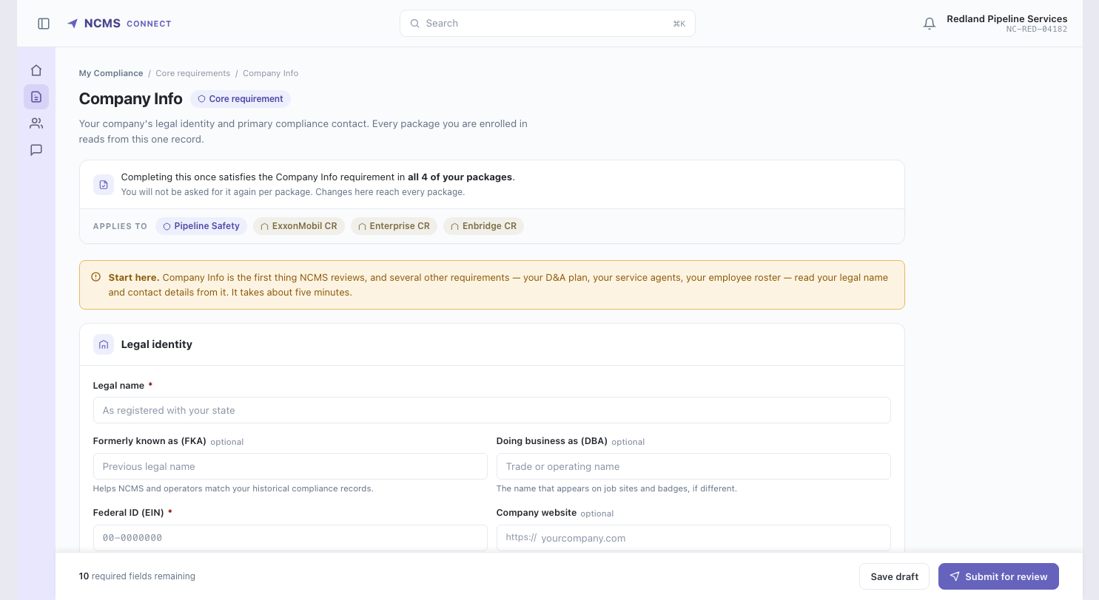
COMPLETE COMPANY INFO
Empty state — first-time entry
Nothing entered yet. Leads with why this comes first and what else depends on it, rather than opening on a bare form.

Slide 3
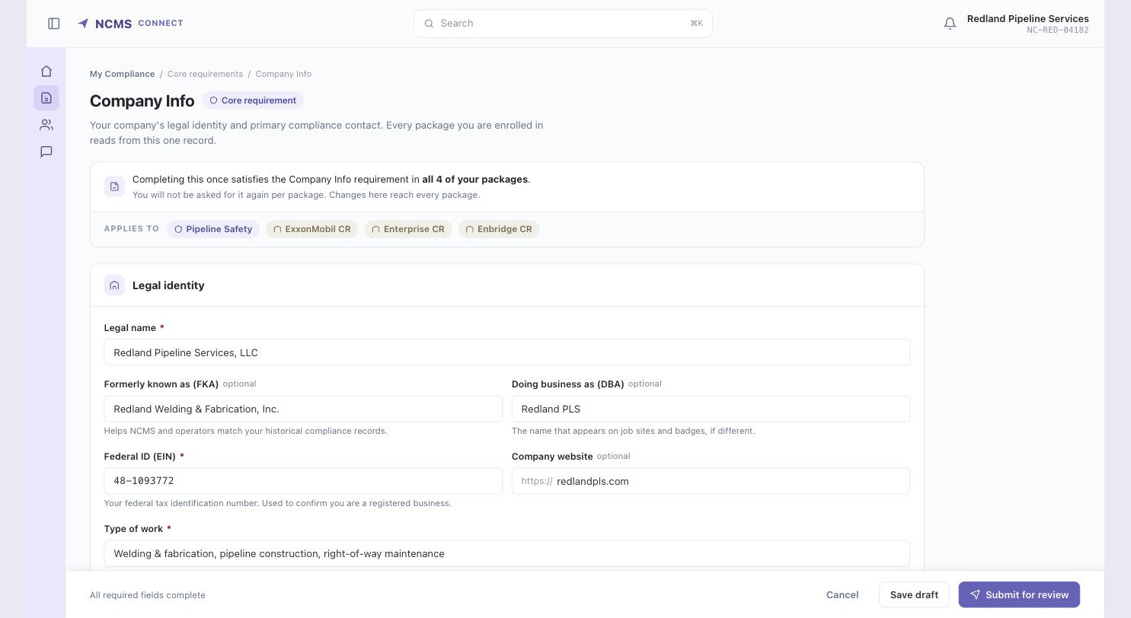
COMPLETE COMPANY INFO
Edit mode — fully entered
Type of work is a plain text field, same as contractor onboarding — the contractor describes their work in their own words rather than picking from a list.

Slide 4
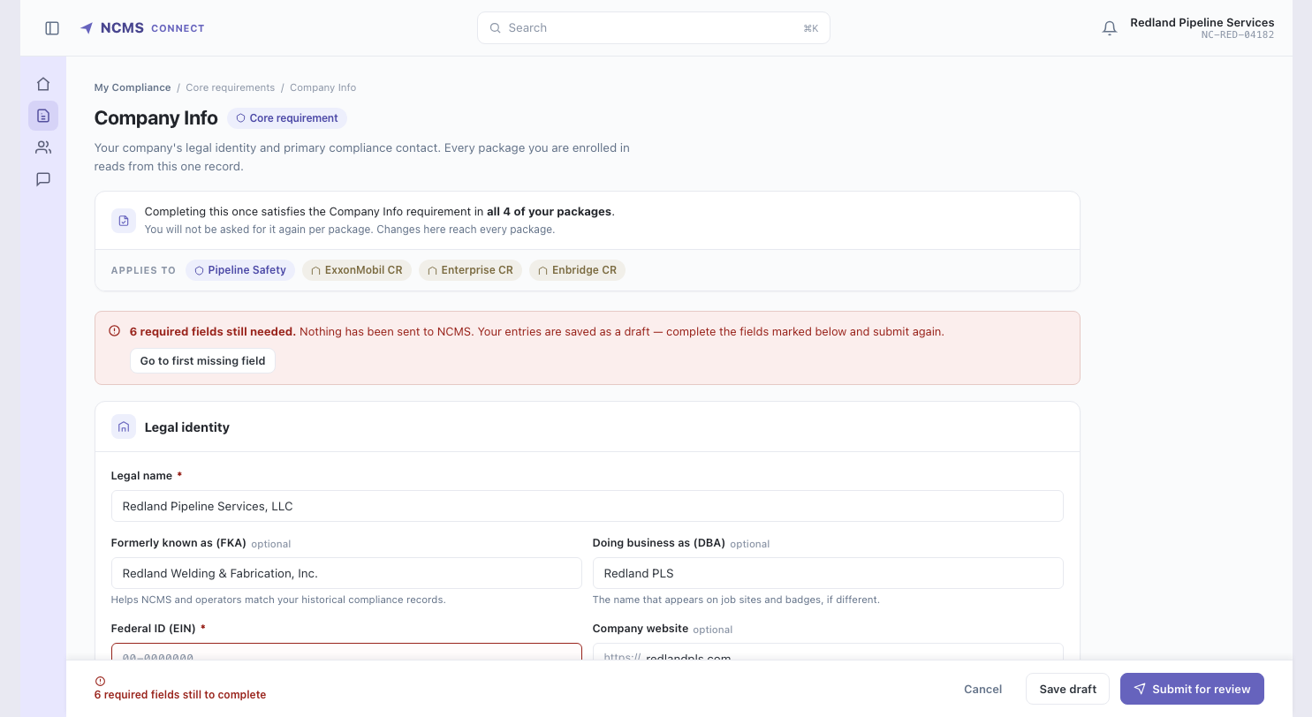
COMPLETE COMPANY INFO
Validation — submit blocked
Address, Federal ID and Type of Work missing. Nothing was sent, the draft is kept, and the count plus a jump-to-first-error sit in the footer.

Slide 5
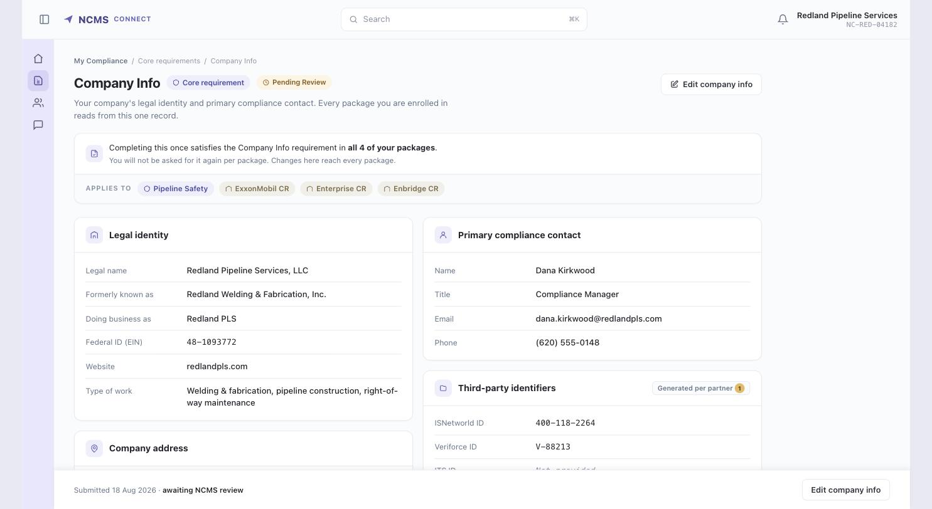
COMPLETE COMPANY INFO
Submitted — read-only, under review
Saved record shown as values, not disabled inputs. A greyed-out form reads as broken; this reads as filed.

Slide 6
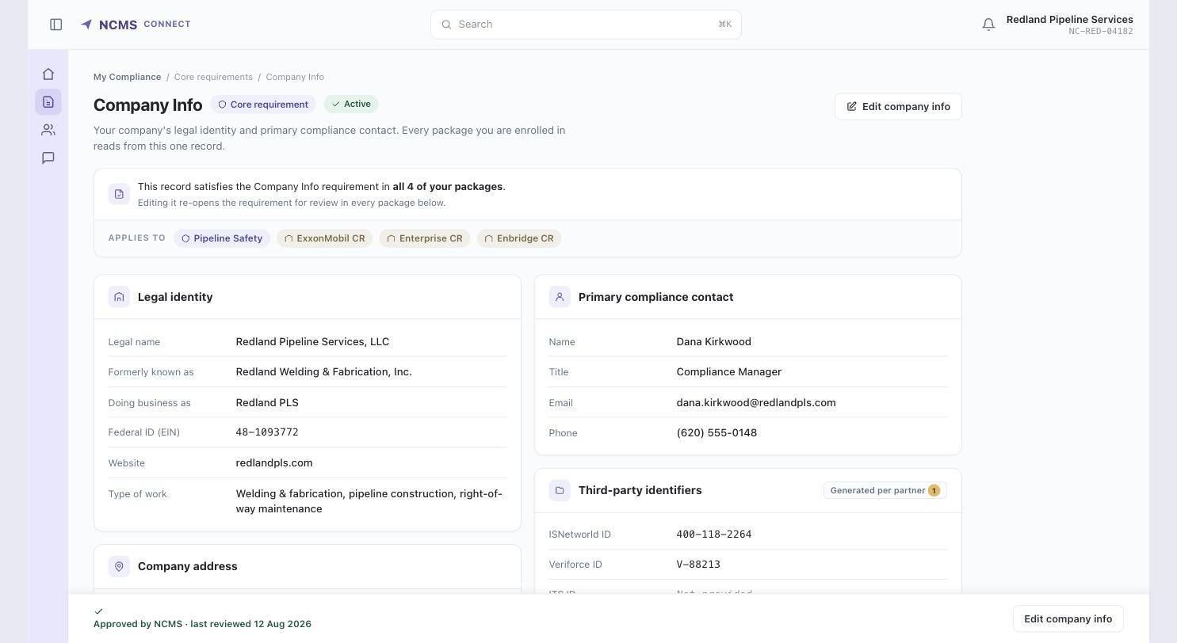
COMPLETE COMPANY INFO
Approved — satisfying four packages
The provenance ribbon switches tense: one approved record now satisfies the Company Info requirement in all four packages.

Slide 7
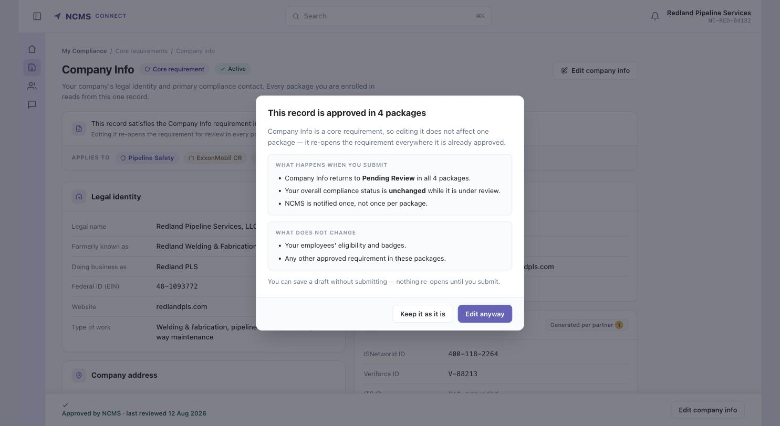
COMPLETE COMPANY INFO
Editing something already approved
Core means the consequence is plural. Editing re-opens the requirement in every package — stated before the edit, split into what changes and what does not.

Slide 8
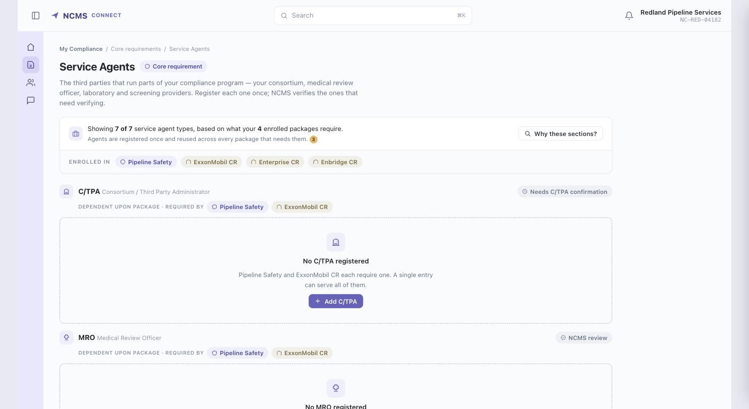
REGISTER SERVICE AGENTS
Empty state — all required types listed
Six sections rendered empty, each naming the packages that require it and whether NCMS reviews it. Nothing is hidden behind an Add button.

Slide 9
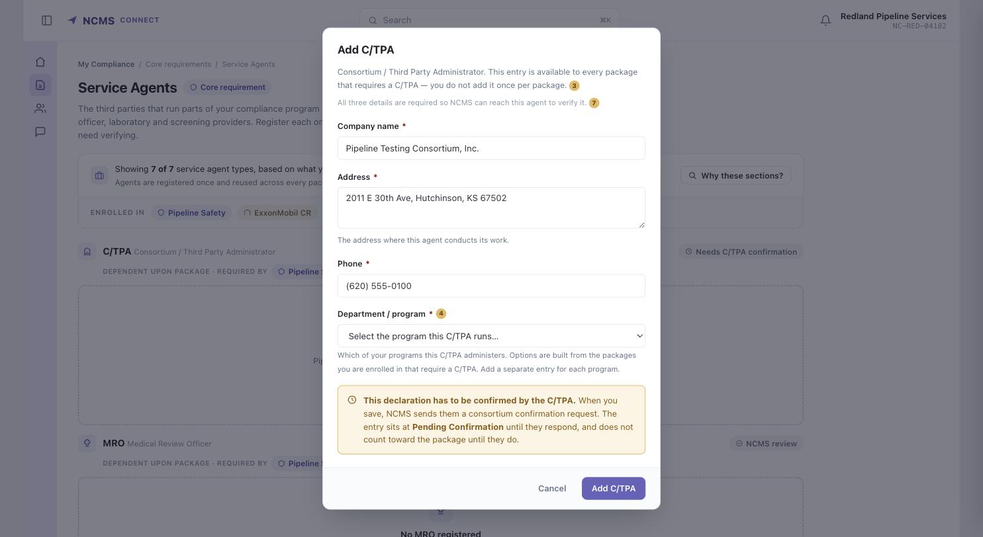
REGISTER SERVICE AGENTS
Add a C/TPA — Department / Program
The one field unique to C/TPA. Options are built from this contractor's own enrolled packages, and the consortium-confirmation consequence is stated before saving.

Slide 10
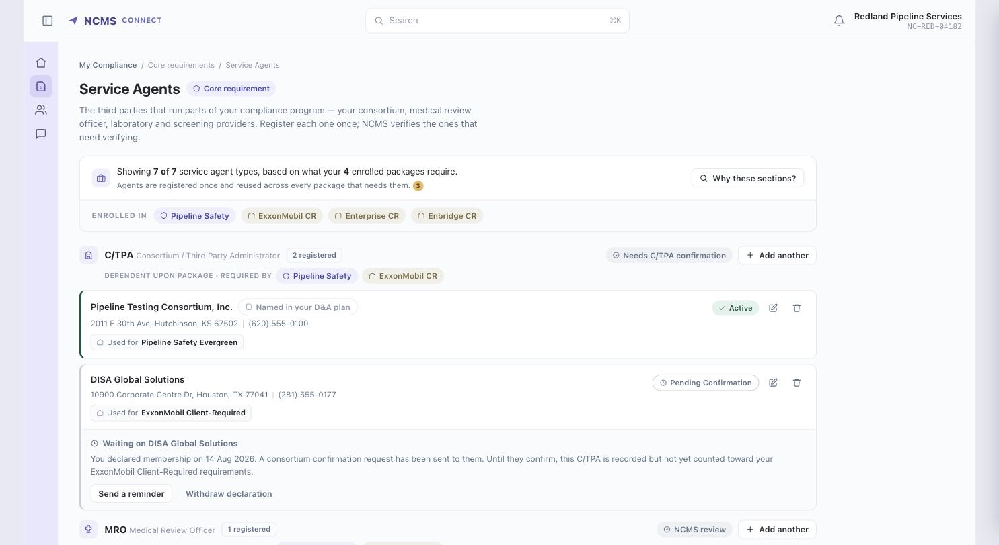
REGISTER SERVICE AGENTS
Populated — nine entries, six states
The real working screen: two C/TPAs, two labs, mixed statuses. Status reads from the left edge as well as the pill.

Slide 11
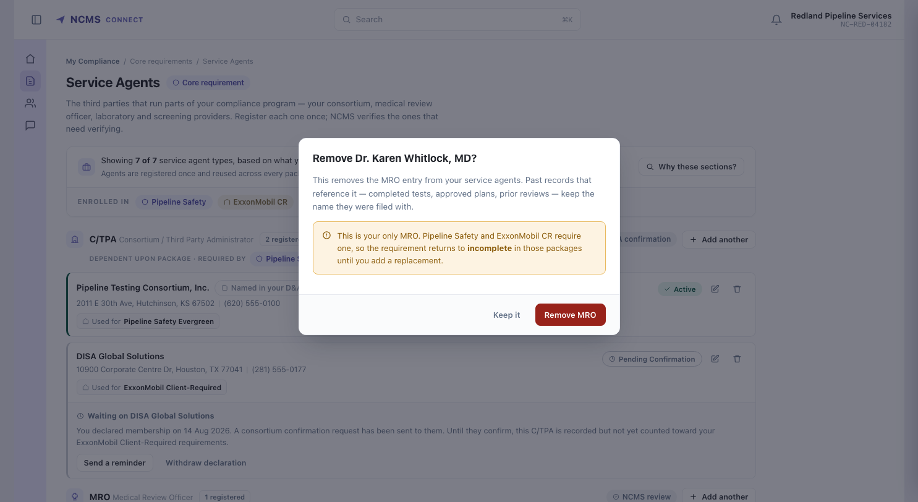
REGISTER SERVICE AGENTS
Removing the only agent of a type
Names which packages return to incomplete, rather than confirming a generic delete and letting the contractor find out later.

Slide 12
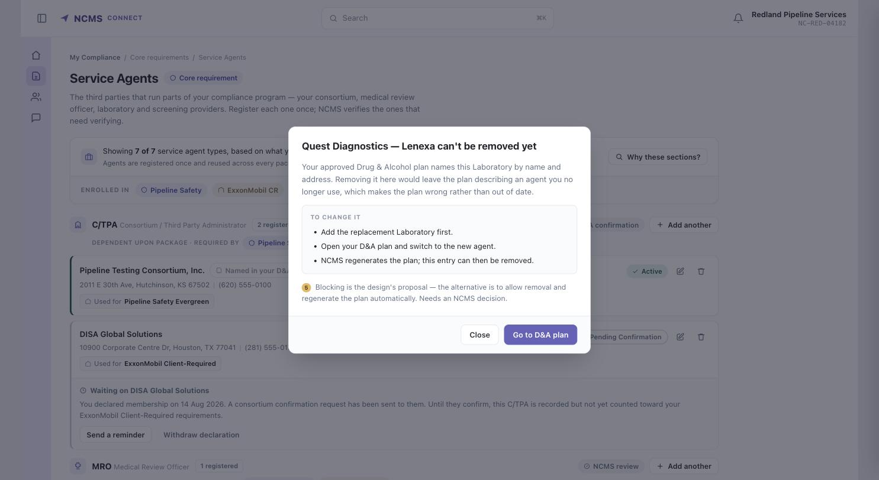
REGISTER SERVICE AGENTS
Removal blocked — named in the D&A plan
Not on the card — surfaced by the design. The approved plan names this lab, so removing it would make the plan wrong. Blocked with the route out stated.

Slide 13
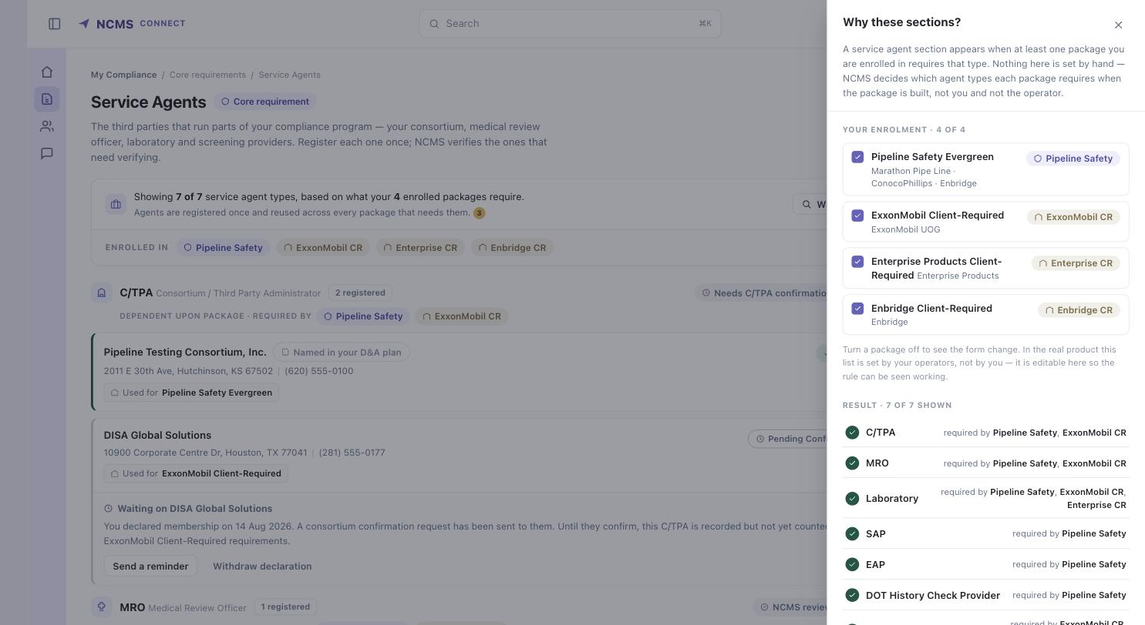
CONDITIONAL VISIBILITY · SCENARIOS
All four packages — 7 of 7 shown
The inspector: enrolment on top, per-type verdict underneath with the exact package chain that produced it.

Slide 14
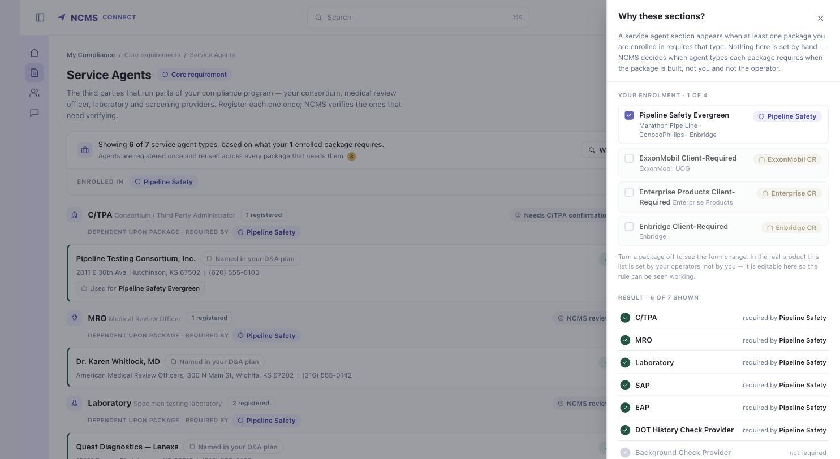
CONDITIONAL VISIBILITY · SCENARIOS
DOT only — 6 shown, 1 hidden
Pipeline Safety alone. Background Check Provider disappears and is named in the hidden strip, not silently dropped.

Slide 15
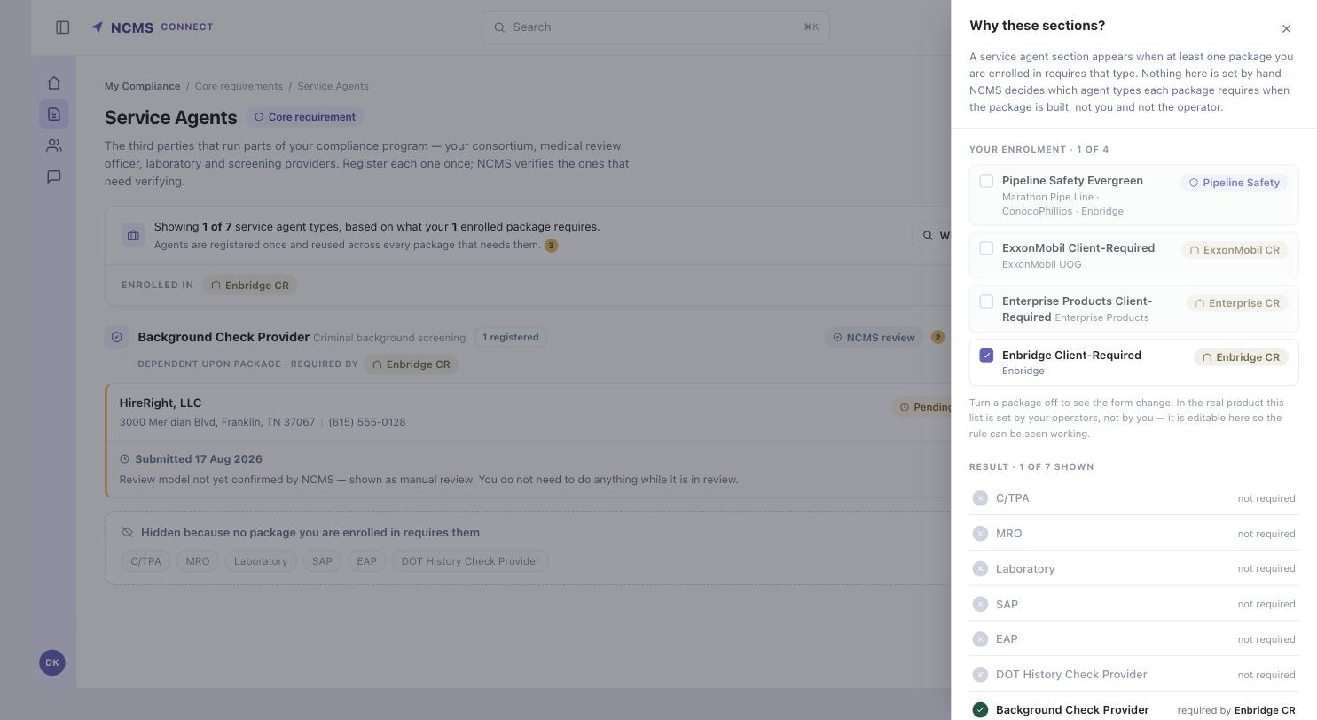
CONDITIONAL VISIBILITY · SCENARIOS
Background-check package only — 1 of 7
The hardest case for the concept: a single non-DOT package collapses the module to one section and names the six that are hidden.

Slide 16
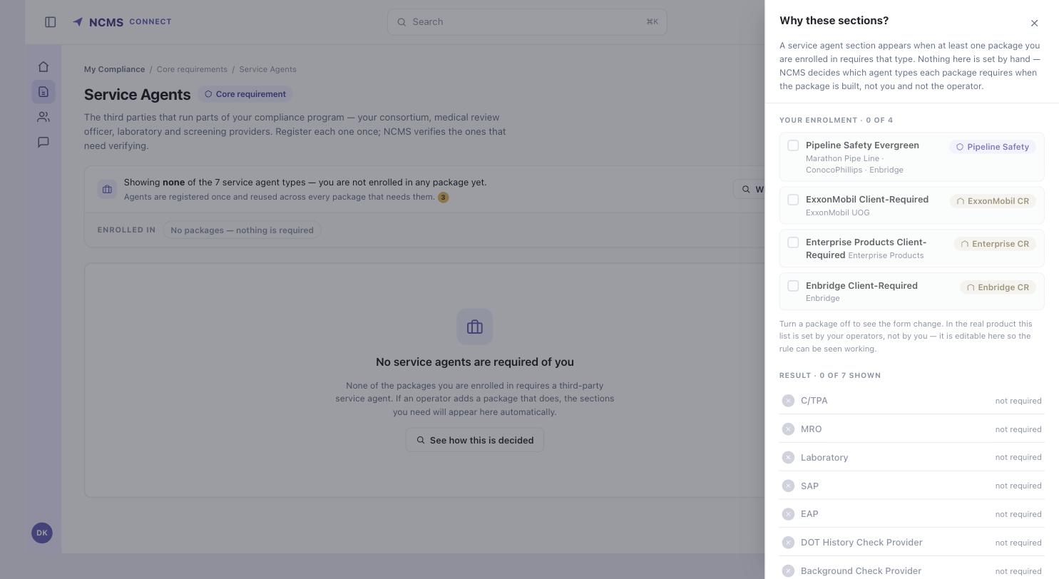
CONDITIONAL VISIBILITY · SCENARIOS
No package requires an agent
The module has nothing to ask for. It says so and explains what would make sections appear, instead of showing an empty form.

Slide 17
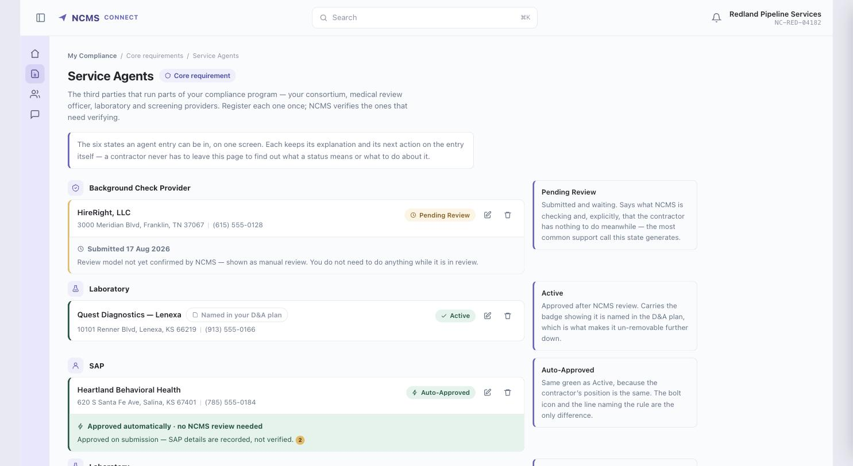
APPROVAL & STATUS · STATES
All six states side by side
Pending Review, Active, Auto-Approved, Rejected, More Info Requested and Pending Confirmation on one screen for comparison.

Slide 18
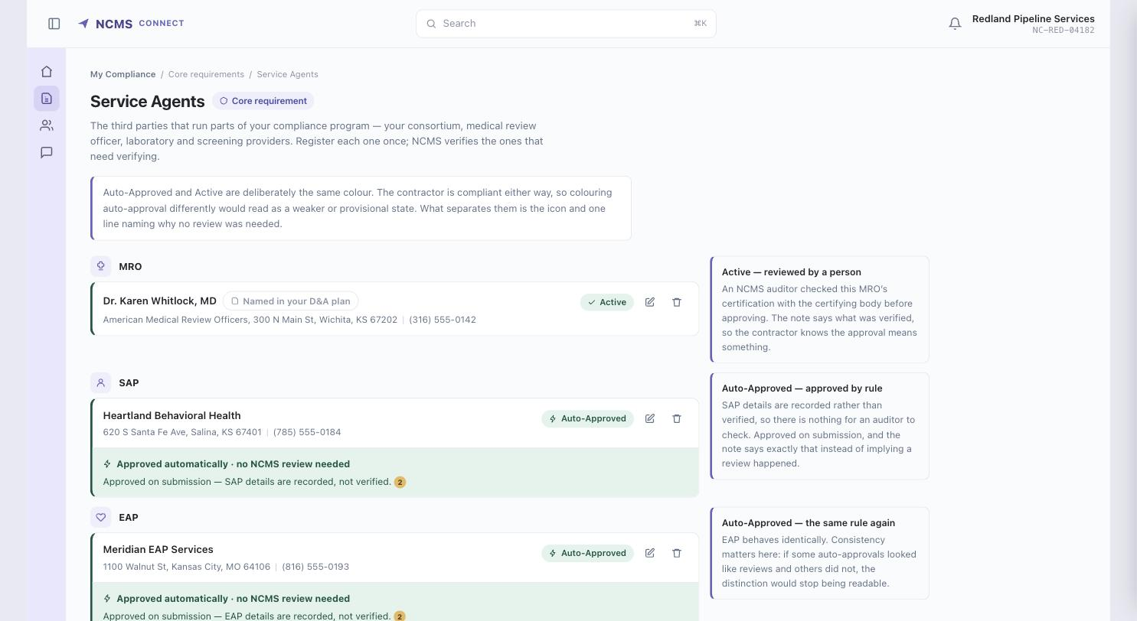
APPROVAL & STATUS · STATES
Auto-Approved vs Active
Both green on purpose — the contractor's position is the same. They differ by icon and one line naming the rule that approved it.

Slide 19
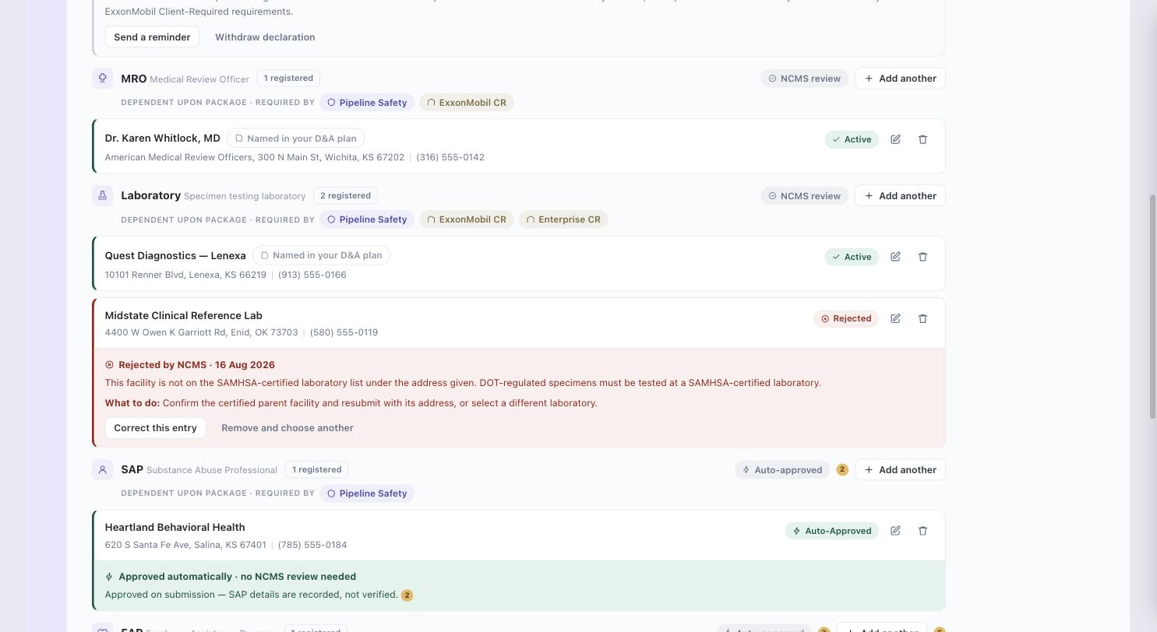
APPROVAL & STATUS · STATES
Rejected — reason and remedy inline
A lab that isn't SAMHSA-certified at the address given. The reason, the regulation behind it, and both ways out sit on the row.

Slide 20
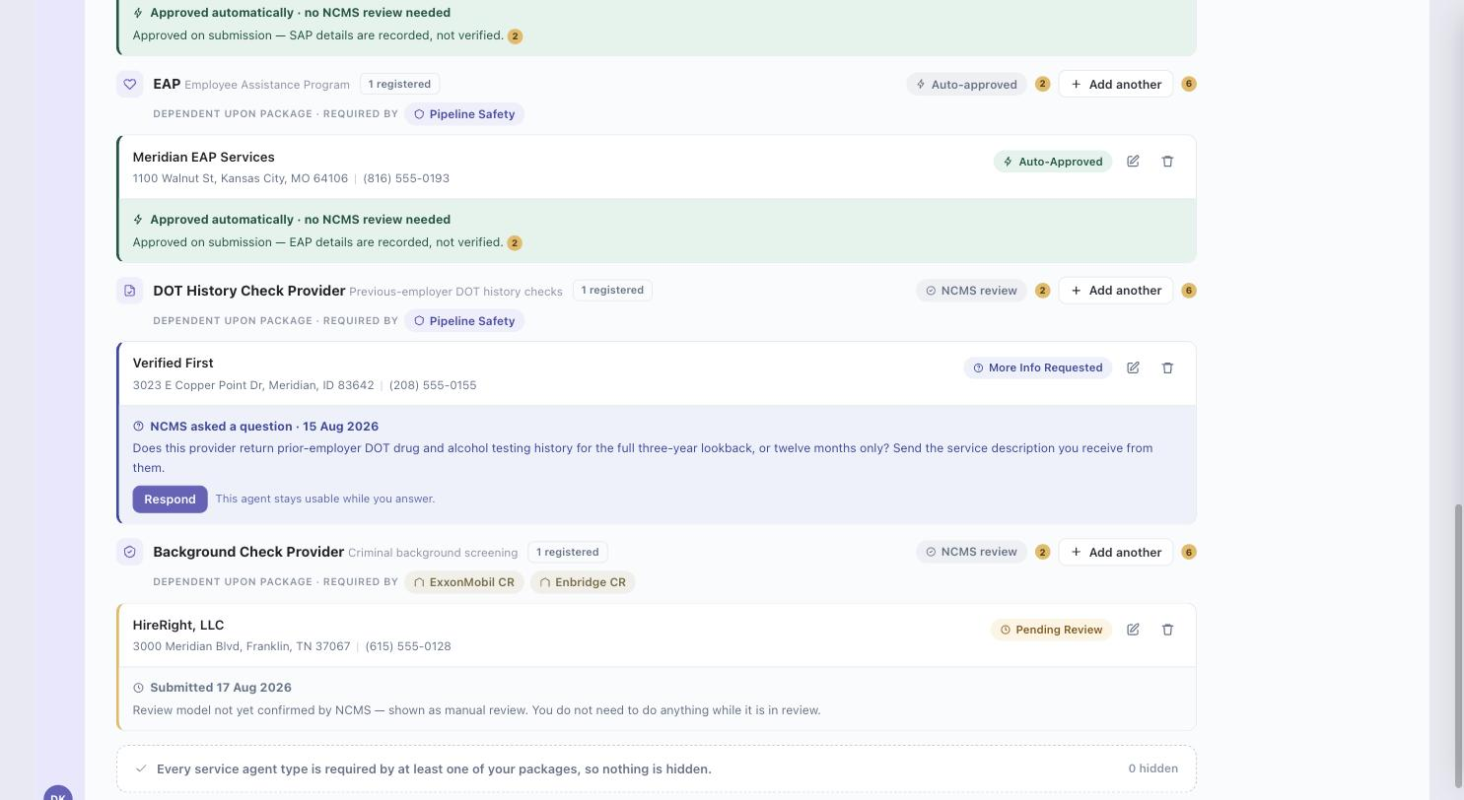
APPROVAL & STATUS · STATES
More Information Requested
A question, not a rejection. The agent stays usable while the contractor answers, and the response form quotes what was asked.

Slide 21
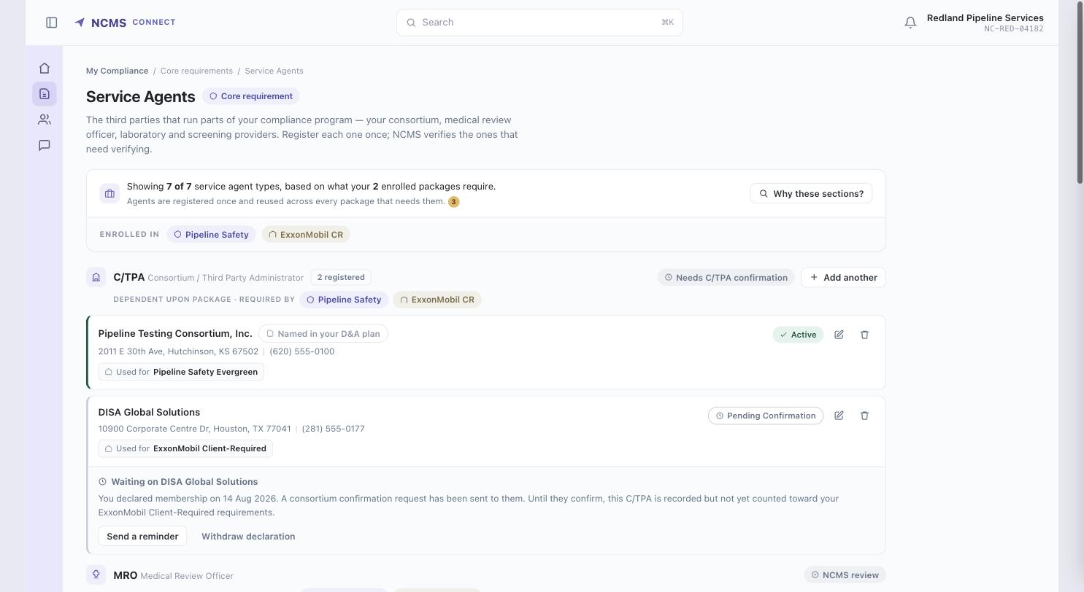
C/TPA CONFIRMATION
Declared — Pending Confirmation
Recorded but not yet counted. Says who is being waited on, when it was declared, and offers a reminder or a withdrawal.

Slide 22
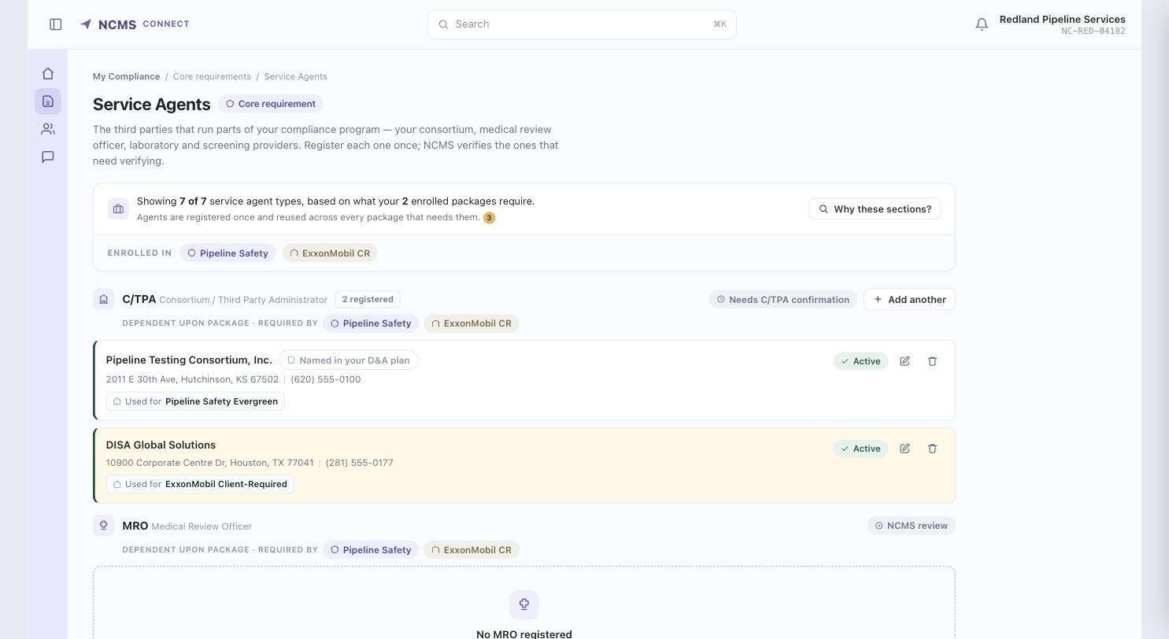
C/TPA CONFIRMATION
Confirmed — now Active
The C/TPA responded. The entry moves to Active and starts counting toward the ExxonMobil package.

Slide 23
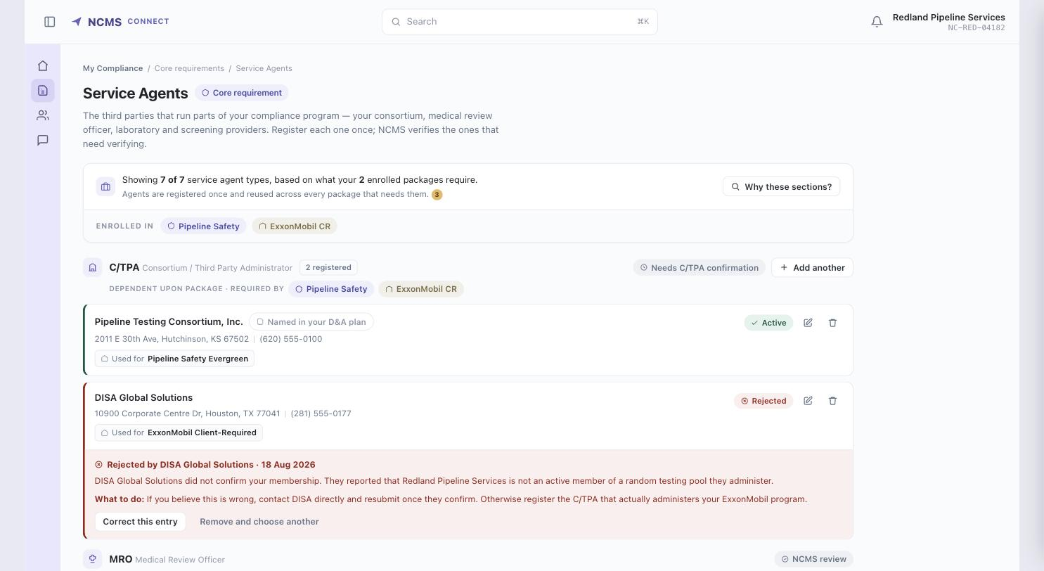
C/TPA CONFIRMATION
Declined — what the contractor sees
A declined confirmation reads as a rejection with the C/TPA's stated reason, and two concrete routes forward.

